Slide 1

The AES Block Cypher
The Advanced Encryption Standard
Block Cipher and Modes
BICS – Sean ACHTATOU
University Of Luxembourg
2017-2018

Slide 2
Overview of this project :
Explanation of AES
What is Cryptography?
The AES Block Cipher
Technical and Scientific Part
Implementation of a the different modes
Conclusion
The Strengh and Weaknesses

Slide 3

1.Explanation of AES

Slide 4

Advanced Encryption Standard
Creators :
Vincent Rijmen
& Joan Daemon
Created :
1998

Slide 5
2. What is Cryptography ?

Slide 6
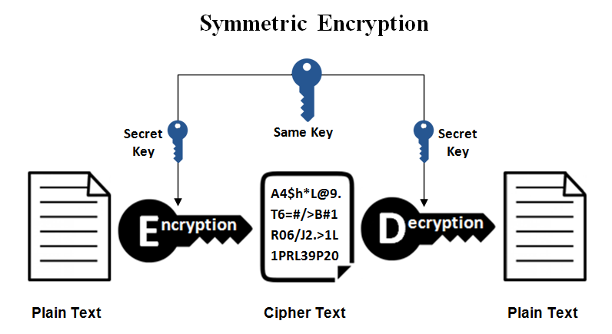
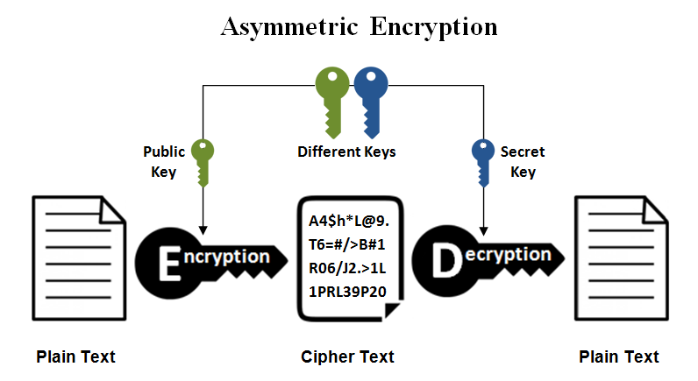
|
|
|
|
|
|
|
|
Symmetric Cryptography
CONFIDENTIALITY
Asymmetric Cryptography
AUTHENTICITY
DES
RSA
Vernam Number
DSA
RC4
INTEGRITY
AES

Slide 7
3. The AES Block Cipher

Slide 8
Block Cipher
Size per Block :
128 Bits (16 Bytes)
The Birthday Paradox
For the 64 Bits :
2(power)32 × 8 B = 32 GB of data safely sent.
For the 128 Bits :
2(power)64 × 16 B = 256 EB of data safely sent.
Example : « This is my project, in this project I will talk about Block Cipher, as below ! »
128 Bits
128 Bits
128 Bits
128 Bits
…

Slide 9
ENCRYPT
DECRYPT
Message
Encrypted message
AES
Encrypt
AES
Decrypt
Key
Output
Key
Output
Message
Initial
Round
Final
Round
Key
Key Expansion
Round
Output
128 Bit
192 Bit
256 Bit
AddRoundKey
SubBytes
ShiftRows
MixColumns
AddRoundKey
SubBytes
ShiftRows
AddRoundKey

Slide 10
4. Technical and Scientific

Slide 11
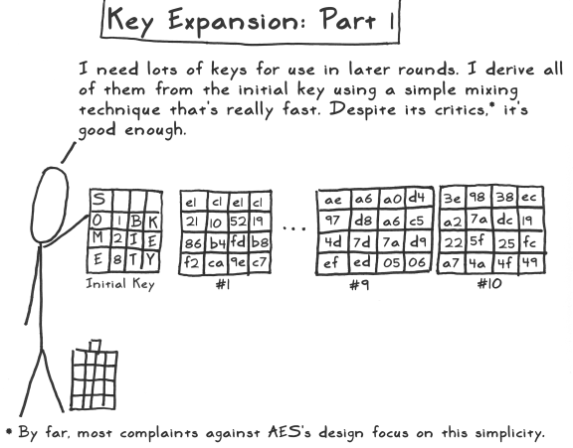
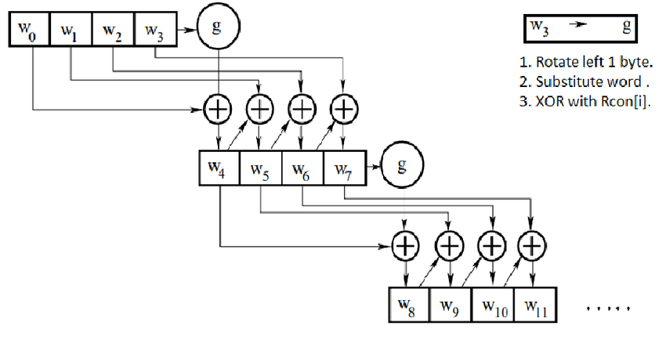
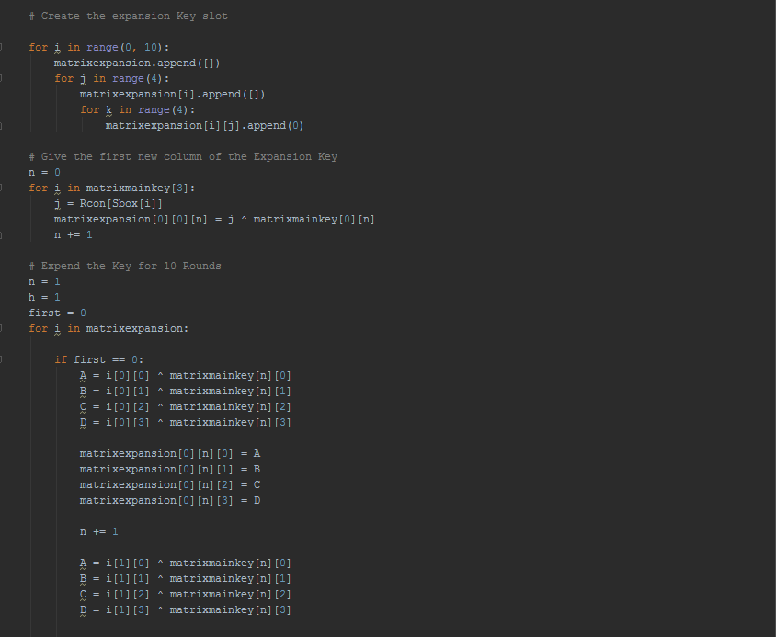
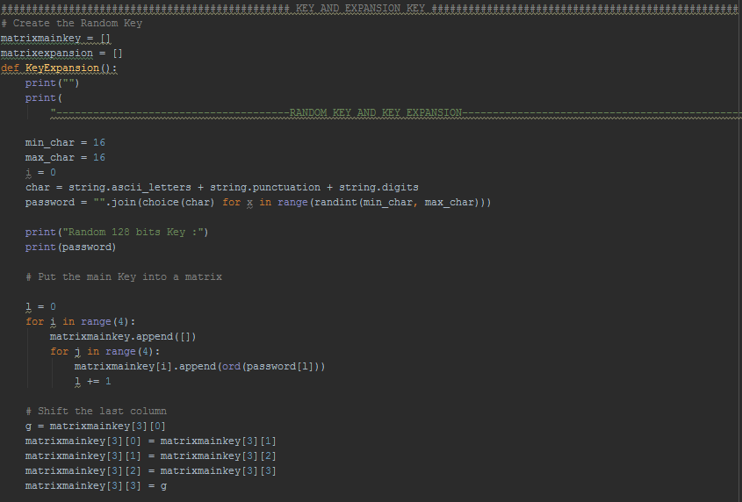
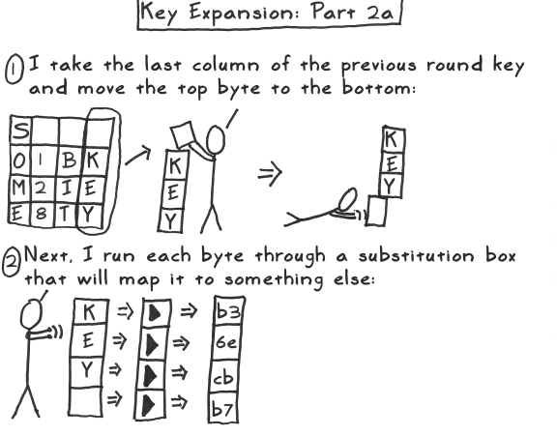
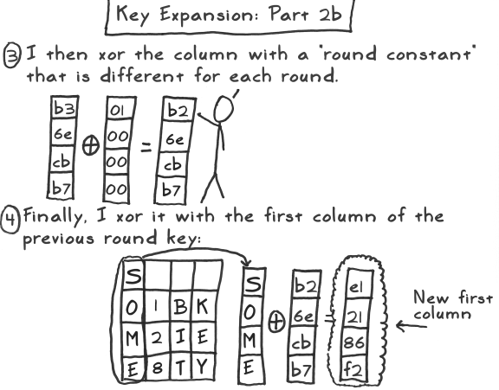
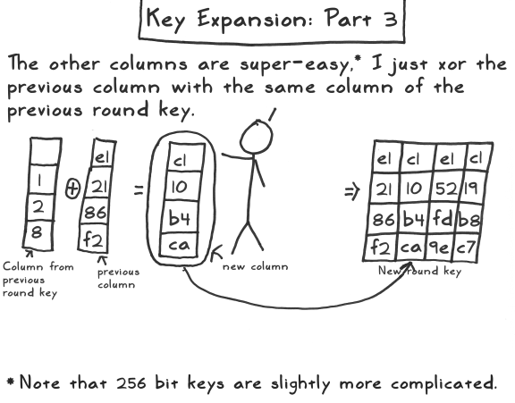
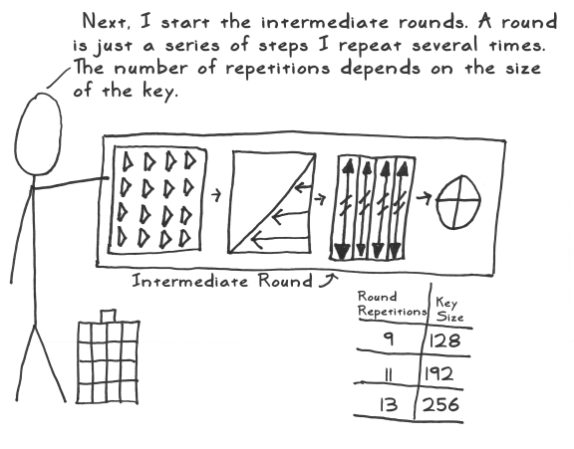
Key Expansion

Slide 12
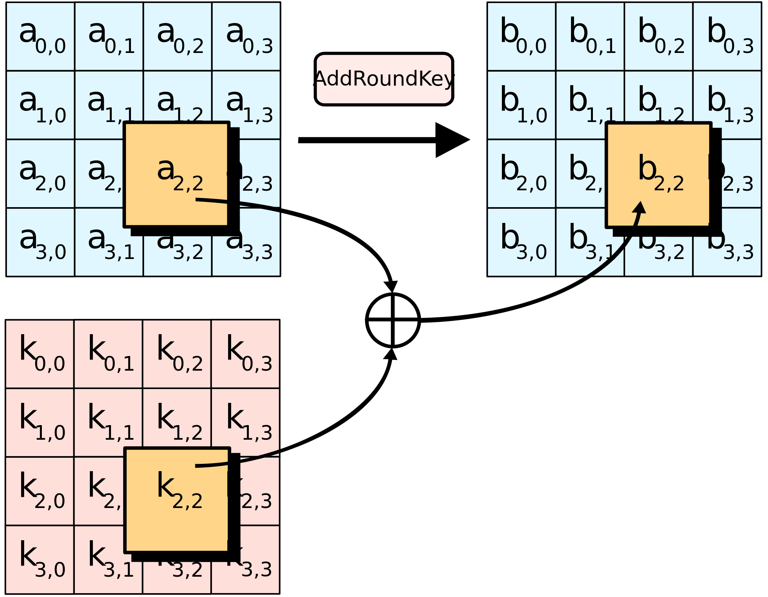
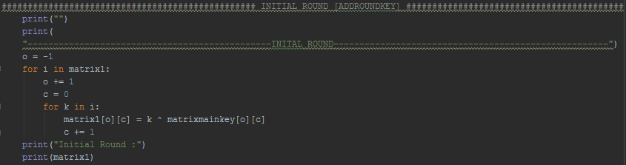
Initial Round
AddRoundKey

Slide 13
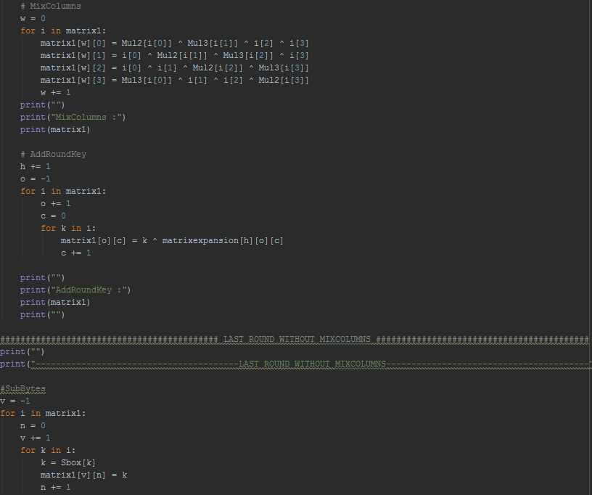
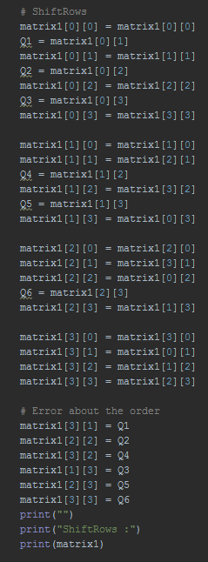
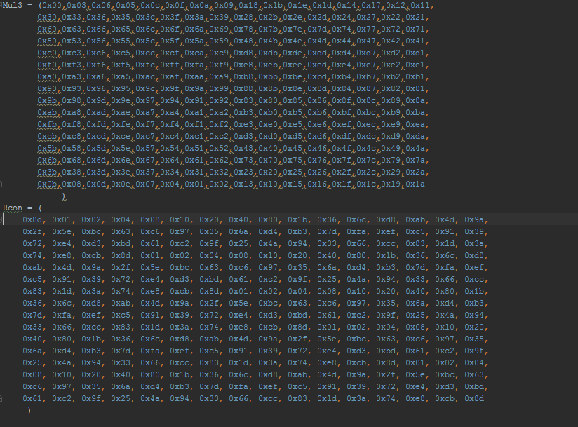
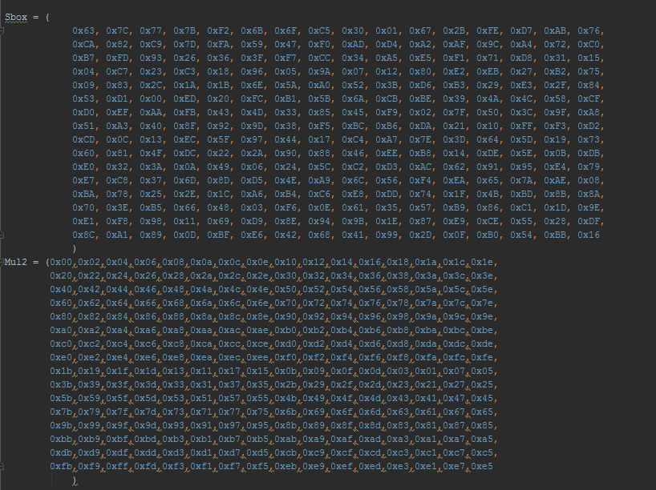
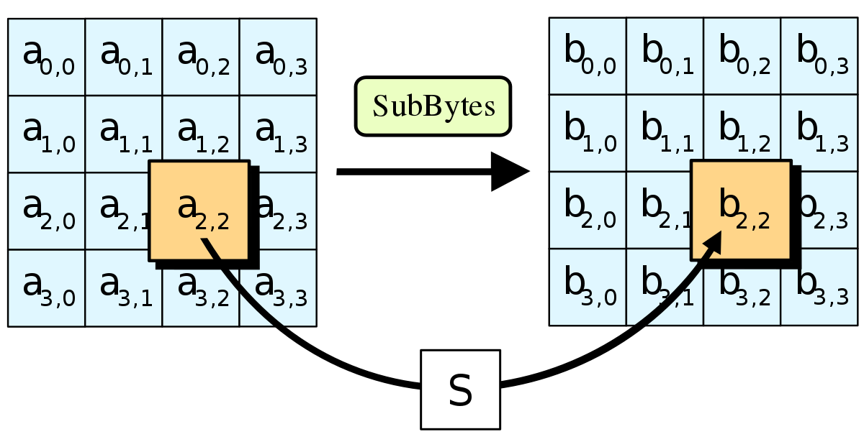
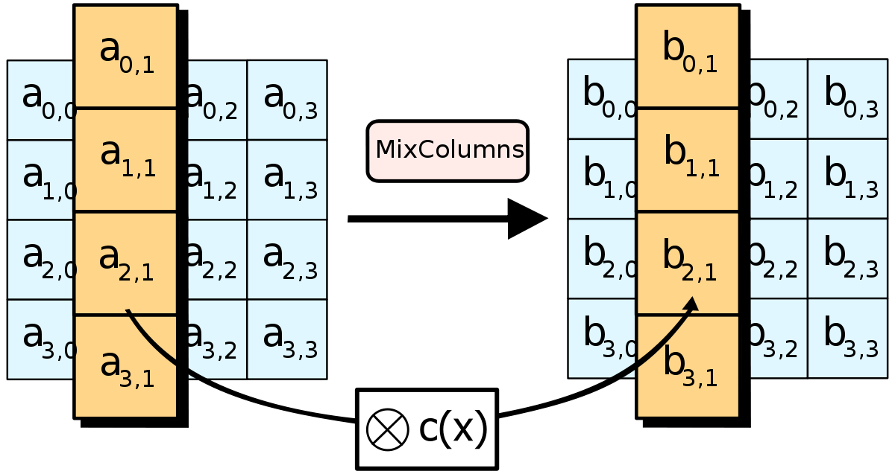
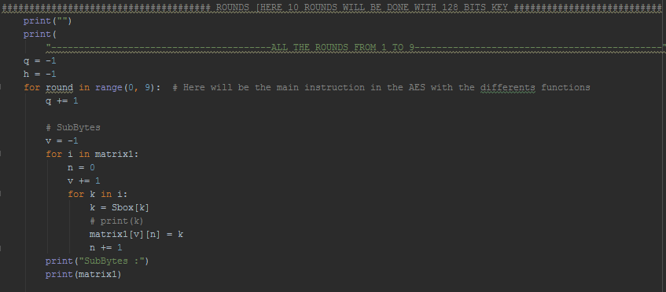
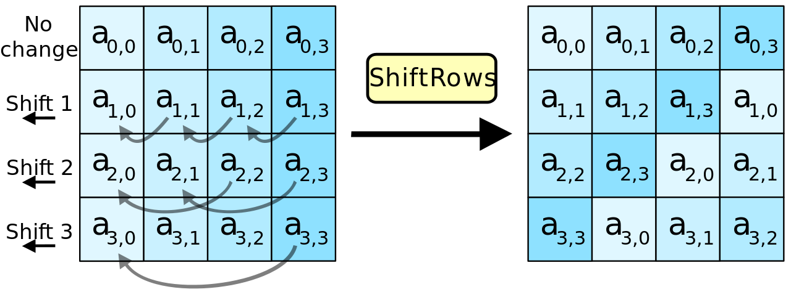
Round
SubBytes
ShiftRows
MixColumns
AddRoundKey

Slide 14
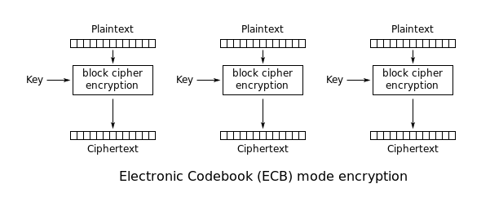
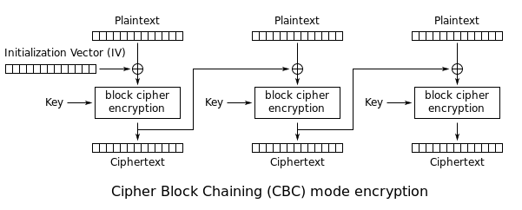
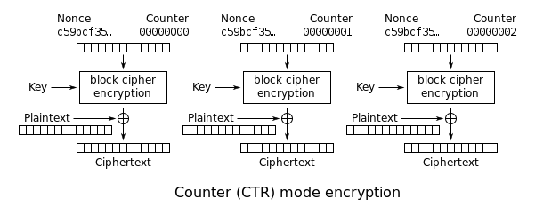
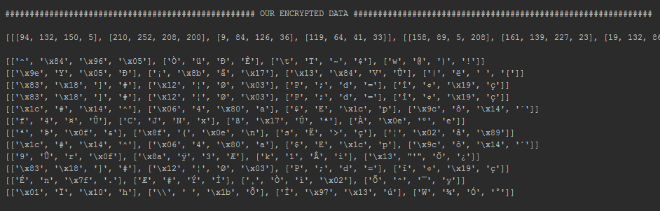
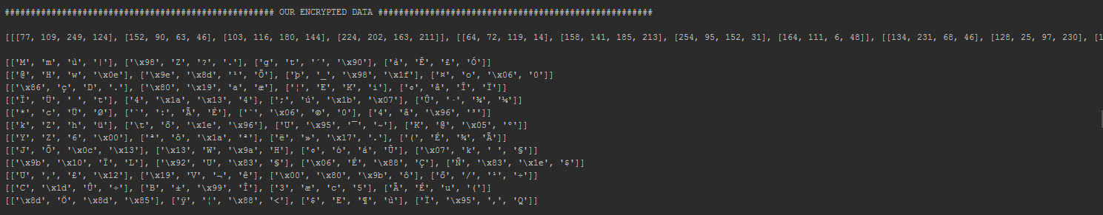
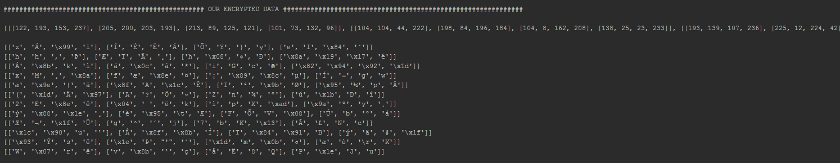
ECB
CBC
CTR
Properties :
Independant Block Ciphers
No Initialisation Vector [IV]
Properties :
- Dependant Block Ciphers
- One Initialisation Vector [IV]
Properties :
- Independant Block Ciphers
- Using a counter
H
E
L
L
O
W
O
R
L
D
!
H
E
L
L
O
W
O
R
L
D
!
H
E
L
L
O
W
O
R
L
D
!

Slide 15



Original Picture
ECB
CTR
CBC

Slide 16
6. Strengh and Weaknesses

Slide 17
BLOCK CIPHER
STRENGHS
WEAKNESSES
CBC is recommended
ECB is not recommended
CTR is recommended
Decryption issues with Windows on Python
Easy to implement
Time to Encrypt
Low storage
Error propagation
Any program is hackable
Can use data of any form
Use of a secret Key
Multiples of modes

